Slide 1

Brain Awareness Montreal
Summer Internship Program
Recruitment presentation for Godfathers/Godmothers (supervisors)
March 2014

Slide 2

Introduction
Objectives:
  To motivate high school and cegep students to start a research career in neuroscience!
  Offer help to grad students in their research projects.
Description:
  Each student is matched with a godfather/mother (graduate student, research assistant, etc) who will supervise them. Together, they will tackle a scientific question that can be answered within one week. At the end of the week, the intern is invited to present his work to the lab members via a powerpoint presentation.
Timeline:
  One week (part- or full-time) between July 1st and August 22nd 2014, according to the godfather/mother’s availabilities.

Slide 3
Why become a godfather/mother?
Get free help on your project!
Practice your teaching skills!
Enhance your CV for grant applications!
And maybe build a long lasting friend/mentor relationship with someone who shares similar passions!

Slide 4
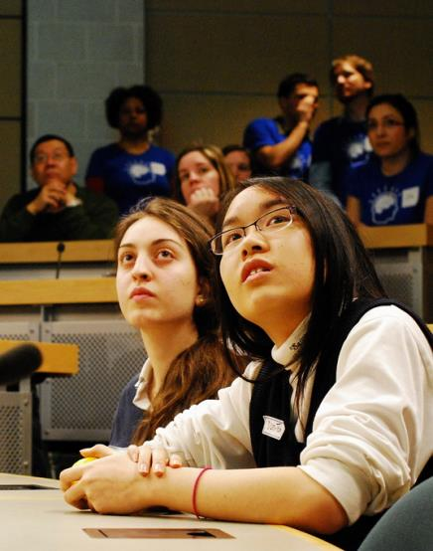
Who are the interns?
Most of the selected students have already been introduced to neuroscience through the Brain Bee competition.
  They know what a dopaminergic receptor is, can identify the caudate nucleus on a brain slice, and are all very excited to see a neuron through the microscope! This training is thus an excellent way for them to fuel the fire of their growing passion for science!
Laura D’Aronco & Dan-Tam Nguyen at the Brain Bee competition, Feb 2012

Slide 5

Who are the interns?
All internship candidates are selected on the basis of their school performance and motivation. Only 10% of the students got an offer last year. Our internship program is highly competitive!
Laura d’Aronco, BrainBee winner 2012

Slide 6
Parent’s consent form
Before meeting your intern, you will receive their parent’s consent form (if < 18 years old). All relevant information (who to contact in case of emergency) will be written on this form. Please keep it easily available during the internship.
An emergency contact will also be provided for interns >18 years old .

Slide 7
What are my tasks?
First, get your supervisor’s approval.
To suggest a small research project (ideal) :
  find a research question
  Discuss with the intern the best protocol to choose
  Guide the intern during the methods
OR to introduce a research method to the intern
To supervise and guide the intern during his/her training
To ensure his/her safety (during the first day, make sure to identify risks in the lab and review the emergency procedures with the intern)
Take pictures of your intern and you in action for our collection! They will be useful for BAM communication material.

Slide 8
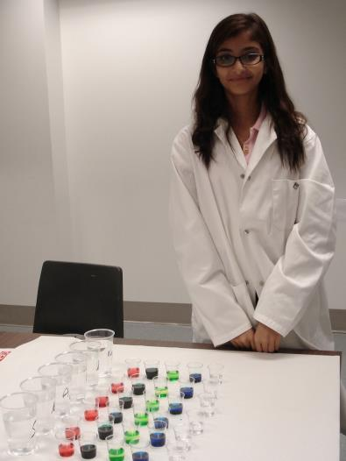
Example of a research question
The main challenge for the godfather/mother is normally to find a research question that can be answered in one-week! Here is an example:
Question: How does color influences taste identification skills?
Methods: Prepare 4 tastes (sweet, salty, acid and bitter) x 5 colors (red, yellow, blue, green, transparent) solutions in 5-mL cups. Ask 10 participants to identify the taste contained in each cup. Calculate % Good answers.
Hayat Beldjilali,
summer 2012
M.Ptito Lab, UdeM

Slide 9
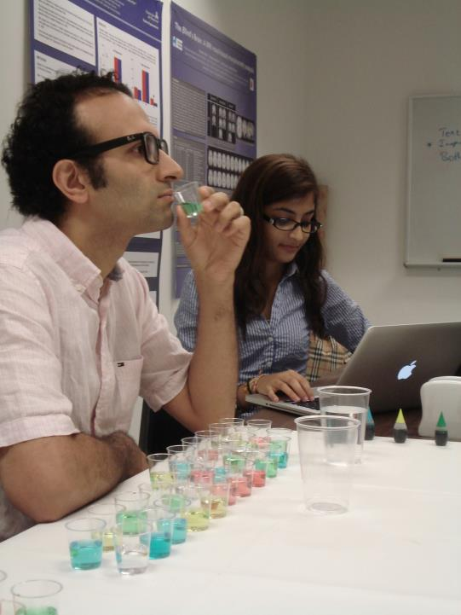
Analysis: Test if there is an effect of color on the identification skills with a repeated measure ANOVA.
Discussion: Are the results in accordance with the literature? Why? Etc.

Slide 10
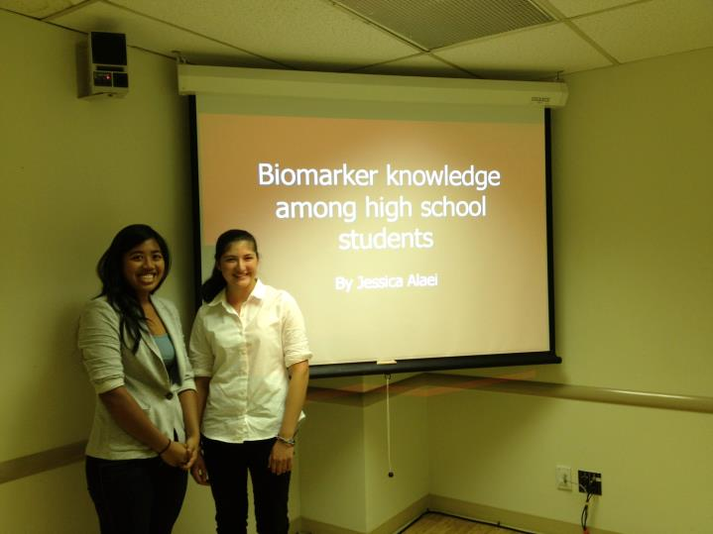
Powerpoint presentation at lab meeting.
Afiqah Yusuf &
Jessica Alaei, summer 2013,
M. Elsabbagh Lab, McGill

Slide 11
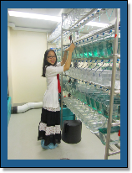
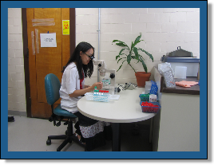
What’s next? Some labs even hired the interns to work in their lab the following summer!
Dan-Tam Nguyen, summers 2011-2012,
Dr. P. Drapeau lab,
UdeM

Slide 12
Questions & Answers
Can I offer a part-time internship?
YES, you decide the schedule according to your availabilities. You can offer full- or part- time internship. Usually, the internship lasts about one week, but 3 days could be enough. Try to complete the internship inside a short period instead of stretching it on many weeks. The interns might have other plans for the summer!
Can I offer an internship during the spring/fall?
NO. All internships must be completed between July 1st and August 22nd 2014. You can hire or keep the intern in your lab afterwards, but this wont be under BAM’s program.
I am having difficulties finding a research question that can be answered in one week. Who can help me?
You are welcome to contact Léa Gagnon, the internship committee head, at internship.bam@gmail.com for assistance. She will be happy to discuss this with you!

Slide 13
Questions & Answers
My lab is doing electrophysiology recordings in the cat/monkey. Can I offer an internship?
YES, but please discuss and obtain your supervisor’s advices and approval for sensitive methods like these. Please also check with the intern what type of technic he can handle. Note that watching an electrophysiology experiment can be a thrilling experience on its own. Make sure you have an “ethics” talk with the intern afterwards (no one wants more anti-animal research demonstrations on the campus!)
I am comfortable to only use one official language during the internship. Is this an issue?
NO, we choose the interns according to their language skills and match them with the appropriate godfather/mother.

Slide 14
How can I sign up?
You can sign up by filling out the form
“Host laboratory Registration: BAM Summer Internship”
available on our website, at :
http://brainawarenessmontreal.com/get-involved/summer-internship-program/

Slide 15
Thanks!

